Slide 1


Clinical Academic Careers
Chetna Modi
HEE, EM Head of Research

Slide 2
Clinical Academic Careers HEE-EM Awards programme-Supporting the HEE/NIHR ICA Pathway
@NHS_HealthEdEng

Slide 3
Background
March 2012 DH launched its Strategy on the development of non- medical clinical academic careers for nurses, midwives and AHPs
In March 2012, the former SHA tasked the East Midlands Health Innovation and Education Cluster (EMHIEC) to enable the delivery of the Strategy within the East Midlands-Clinical Academic Careers Steering Group
Furthermore
HEE’s Mandate from Government April 2016-2017 states that “to support research, innovation and growth HEE will: continue to support clinical academic careers for all professionals”
@NHS_HealthEdEng

Slide 4
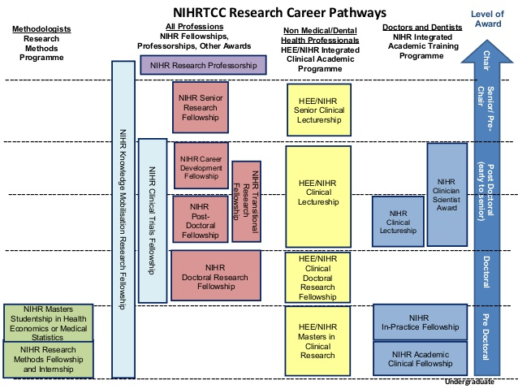

Slide 5
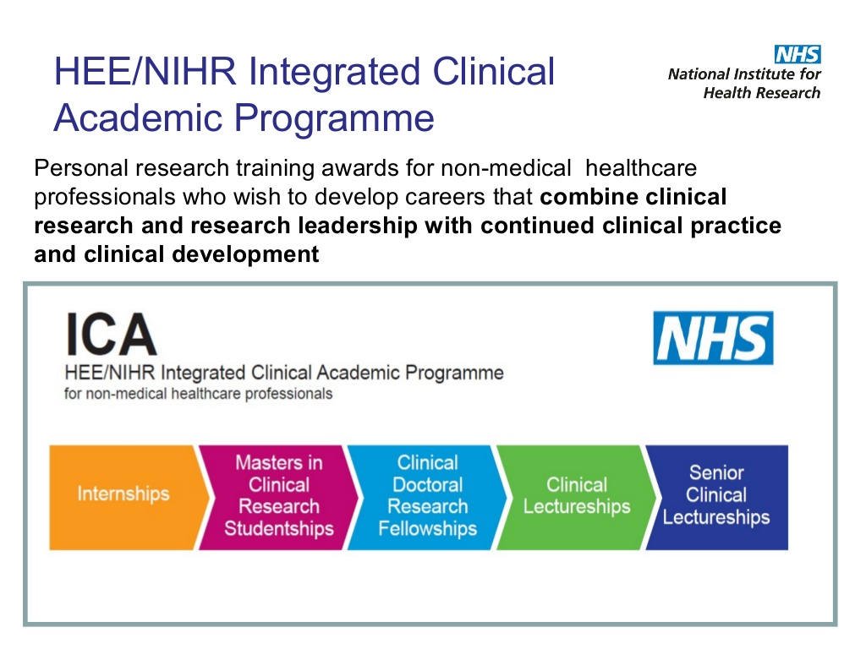

Slide 6
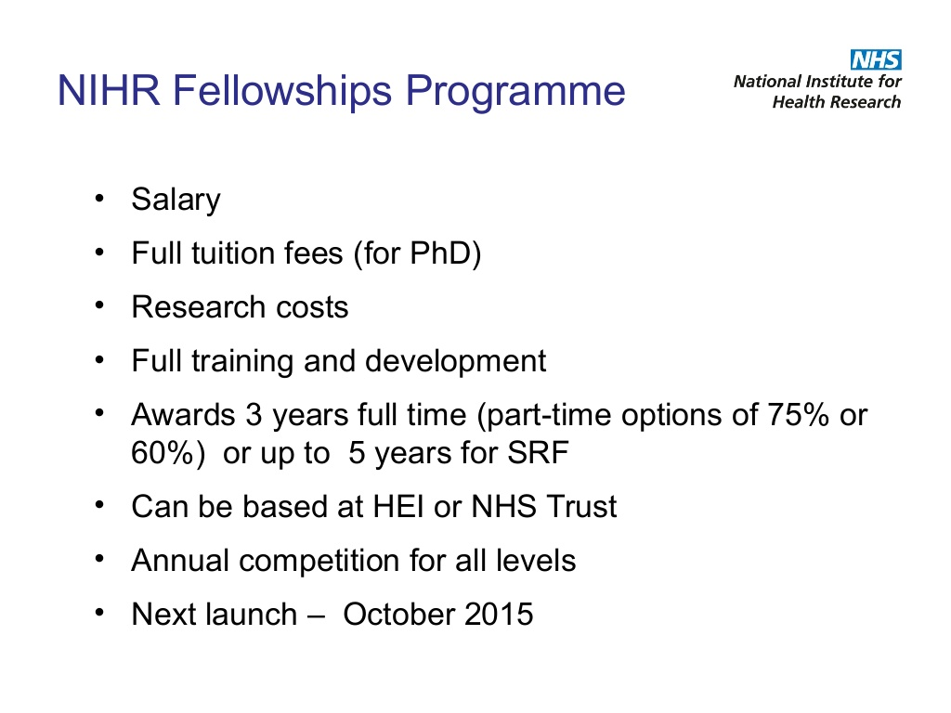

Slide 7
Background
HEE-EM Clinical Scholar Awards are the East Midlands response to the Government’s strategy
Scheme is in its 5th year to date. So far 120 students have have been through the programme
48 day FUNDED opportunities (over 6/9 months) for Nurses, Midwives, Allied Health Professionals, Health Visitors and Pharmacists to develop research skills and conduct a small research project
@NHS_HealthEdEng

Slide 8
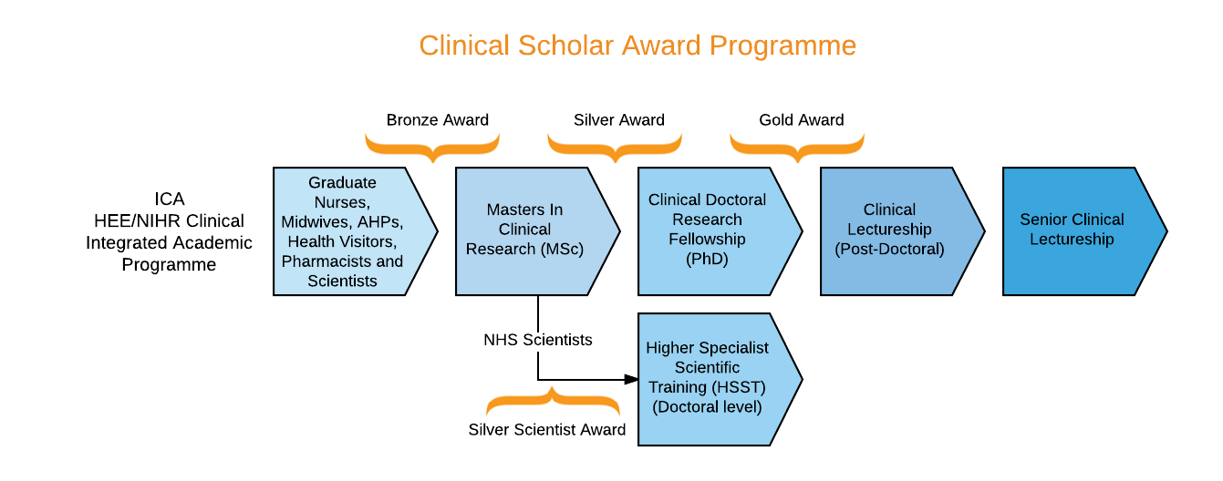
The Clinical Scholar Awards Pathway
@NHS_HealthEdEng

Slide 9

Bronze Award
For those without formal Masters qualification
Structured 5 day educational programme
Support from experienced Clinical Academic Mentor
5 facilitated Action Learning Sets-delivered by an academic
Enhance ability to compete successfully for the next stage of the Clinical Academic Pathway e.g. MRes
@NHS_HealthEdEng

Slide 10
Bronze Award-Educational programme
Induction, literature searching and critical analysis of qualitative literature
NICE Guideline how are they developed
Utilising quality improvement techniques to put evidence into practice
Introduction to quantitative and qualitative research methods
nVivo training-analysing qualitative research data
Presentation and qualitative report writing skills
Preparing for your MRes application
Formal presentation
@NHS_HealthEdEng

Slide 11
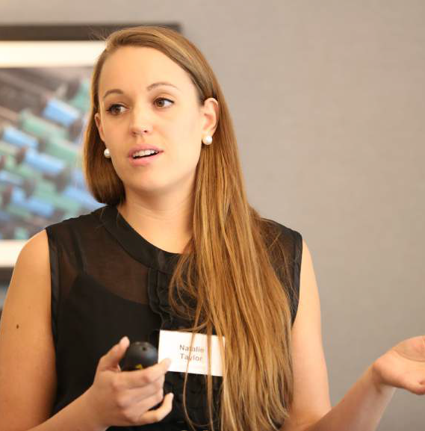
Outputs
7,000 word dissertation (60%)
3,000 reflective piece (15%)
Presentation (25%)
All assessed and marked
@NHS_HealthEdEng

Slide 12
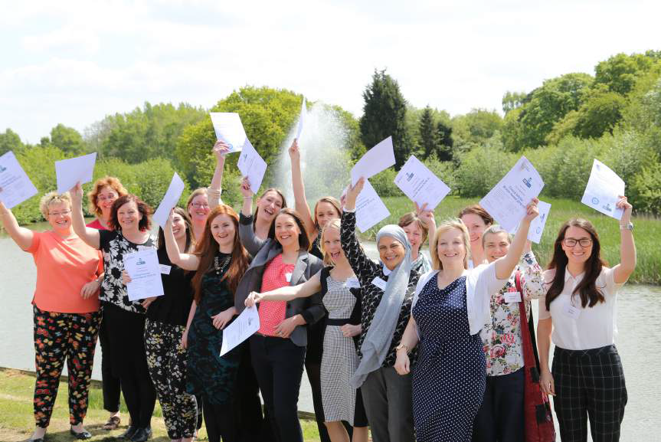
@NHS_HealthEdEng

Slide 13

Silver Award
For those with Postgraduate Masters qualification
Education by the University of Lincoln
Bespoke educational programme and development plan based on training needs assessment
Support from experienced Clinical Academic Mentor
Enhance ability to compete successfully for the next stage of the Clinical Academic Pathway e.g. NIHR PhD
@NHS_HealthEdEng

Slide 14

Silver Award- Education Programme
Study Design
Review of research philosophy and ethical principles
Advanced literature searching
Critical appraisal of literature
Statistical analysis and software
Research methods qualitative and quantitative
nVivo for qualitative data analysis
Academic writing for publication
Delphi techniques economic evaluations in healthcare
Patient and Public Involvement (PPI)
Applying to the NIHR for PhD funding

Slide 15
Silver Award- Outputs
5,000 word literature review
A fully worked up PhD proposal in line with the NIHR requirements
Ethics approval
Presentation (formative)
Mock NIHR panel interview
@NHS_HealthEdEng

Slide 16
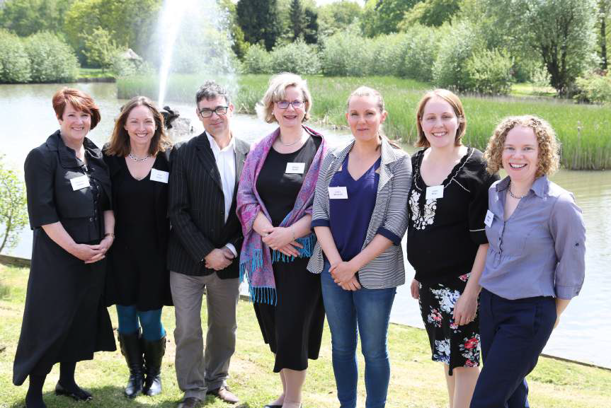
@NHS_HealthEdEng

Slide 17

The Gold award
The Gold award supports PhD qualified clinicians to apply to the HEE/NIHR ICA Clinical Lectureship.
Training is tailored to reflect the individual training/developmental needs of each scholar.
£15k from Training Development Funds is available for each scholar to support learning
@NHS_HealthEdEng

Slide 18
The Gold award
4 Gold scholars in place
Aiming for the NIHR CL 2018
Highly competitive
Brings recognition to individuals and organisations HEI and Trust
For clinicians working towards their Chair (Professorship)

Slide 19
Clinical Scholar Award programme – Benefits
Expose frontline clinicians to research
Research is important in questioning what can be done better and how can we improve patient safety, outcomes and experience
Build an evidence base from frontline clinicians
Clinicians bring a unique insight into research, it is a 2-way street

Slide 20

Top tips
Multi organisational effort for ‘push and pull’ HEE-EM, HEIs and NHS Trusts
Research capability development needs to be in peoples’ job plans
@NHS_HealthEdEng

Slide 21

Conclusions
Bronze and silver awards were very successful over 120 clinicians through the pathway
Bronze and Silver awards now commissioned to HEIs in the East Midlands
Gold award has been launched and is being delivered by the HEE central team this year

Slide 22
Testimonials
“The…programme provided an opportunity to learn about the research process in a protected way… My mentor has become a research partner and wants to work alongside me on the next project.” (Practice Development Nurse, 2013/14 Clinical Scholar)
“…You find out what is involved in becoming a researcher and you get to find out every step of the process. I hope to get our work into two or three papers. It’s been so important to me that programmes like this are running and to be given such an opportunity is something I’m truly grateful for…”(Physiotherapist, 2013/14 Clinical Scholar)
“It is a must for clinicians” (Physiotherapist, 2013/14 Clinical Scholar)
“Excellent showcase of hard work and projects that a very talented group of health care staff have done” (Line Manager at 2014 Presentation Event)
@NHS_HealthEdEng

