Slide 1


Clinical Academic Careers and Development Opportunities
Dr Claire Diver PhD PGCert Res Grad Dip Phys
Co-Director MARM and Silver HEEM internships

Slide 3
History and context: 20 years ago
1995 House of Lords select committee: Medical research and the NHS reforms: disincentives to medical academic careers
1997: The Richards report
1999: DH and JCC: need a clearer career track
Academy of Medical Sciences “Prof John Savill" Report, championed the creation of new opportunities for academic training for doctors.
"The Tenured Track Clinician Scientist: a new career pathway to promote recruitment into academic medicine"
2002: The clinician scientist scheme
Postdoctoral clinical research training for Clinical Scientists.
Notes:
(1) "to assess any barriers to academic training associated with recent changes in clinical career structure."
(2) "to develop constructive suggestions for developing career pathways for trainees in academic medicine."

Slide 4
Nursing, Midwifery, AHPs
New as academic subject
latter half of 20th century
Most non-medical HCP education moved into HEIs in 1980s and 1990s
Require evidence for practice
Need academic excellence in those who lead clinical practice
Masters and Doctoral training and expertise

Slide 5

_{Research is core NHS business}
CAs important part of a well-rounded clinical research community
Developing the best CAs requires national oversight, strategic vision, political commitment, focused local implementation
Training requires partnerships between HEIs and providers
Workforce planners and local providers should include CA in workforce plan.

Slide 6
Developing a Workforce skilled for Research and Innovation HEE, 2014 p.29
“objective is to develop a more flexible workforce that is able to respond to the changing patterns of service. It will need to develop a workforce that embraces research and innovation to allow it to adapt to the changing demands of public health, healthcare and care services where staff are at the forefront of implementing the Innovation Health and Wealth Strategy”

Slide 7
Developing a workforce skilled for research and innovation HEE, 2014 p.30
“HEE should support clinical academic careers for health professionals and also seek to increase numbers of staff across all clinical and public health professions with a proper understanding of research and its role in improving health outcomes”

Slide 8
Why do we need clinical academics?
CLINICAL ACADEMICS “ ask questions about what they can do better, and because they are working with patients, they can see the gaps that lead to the questions, and they have the curiosity to seek the answers.”
“We need the inspirational people to draw people in and help them to dream the dream.”
Professor Dean Jones, NIHR dean for faculty trainees

Slide 9
The need for organisational change
Wider cultural change required across the NHS
R&D affects income; estimated to be worth £30m at University Hospitals Birmingham
“research is still seen as pulling people away from clinical care. But when you have clinicians involved in research it can make an immediate transformational difference that really brings great value.”
Tim Jones, Director of Delivery University Hospitals Birmingham
Notes:
To attract the best clinicians you need a culture of research and innovation. Being known for research = higher calibre of candidate. Can also affect the reputation of a trust locally, nationally and internationally

Slide 10
The need for organisational change
“There’s a growing body of evidence that being a research-active NHS organisation is good for patient care.
Clinical research means patients get access to newer treatments, faster; it can generate income, and help to build trust reputation and attract and retain the best staff”
Tracey Batten, chief executive Imperial Colleg Health Care Trust

Slide 11
The need to consider where clinical research is situated
Research should not be the preserve of the acute NHS trust
Direction of care is into mental health, long term conditions and therefore community provision.
Need to consider the long game
Notes:
Consider Cats work in third sector provision

Slide 12
Benefits to the organisation
Research skills that translate to clinical practice
Gaining consent
Research grants and partnerships with industry
Learning how to build a business case
Drive innovation
Bring economic benefit
Improve patient care
“It builds staff confidence, they feel more able to ask questions and challenge – and that benefits patient care” Wendy Tindale, Consultant clinical Scientist and scientific director, Sheffield Teaching Hospitals

Slide 13
Benefits to the organisation
“While it may seem challenging to create half time clinical roles, it is not impossible, and the fears that staff would leave the trust once they completed their research, or move full time into academia, have proved unfounded,”
Our vision is to develop the best in care. To do that, there must be a focus on quality, patient experience, research and innovation, and a fit for purpose workforce. Research is at the very heart of our values.”
Ron Kerr, Executive vice chair Guys and St Thomas’s Foundation Trust

Slide 14
The clinical academic journey
“You also have to accept that something’s got to give – you can’t do everything perfectly.”
“It can be hard to be the one breaking through, but we’re making it easier for the people coming behind. That’s good for the NHS and good for everyone.”
Gillian Chumbley, Nurse consultant. NIHR clinical lectureship

Slide 15
The clinical academic career journey
“What we all want is improved care and better outcomes and what we want is a system that is focused on this. Clinical academics are the sort of people who are curious, who will ask questions, and that leads to cycles of continuous improvement. It’s really important that clinical services are research-active, and it needs to be the case throughout the system.”
Nadine Foster, Physiotherapist, NIHR/HEE Research Professor

Slide 16
NO RESEARCH is not an option
Under the Health and Social Care Act HEE has STATUTORY responsibility to promote research
HEE mandated to develop a more flexible workforce that embraces research and innovation and can adapt to the changing demands of public health, healthcare and care services.
Vital that Research is seen as “an important constant, rather than a ‘nice to have”
Nicki Latham, Chief Operating Officer HEE

Slide 17
You can be PIONEERS
CURRENTLY there are no job descriptions for clinical academics
BUT THERE is a pathway AND
THERE IS a will
BUT you will have to pave the way: be innovative; be persistent; demonstrate the need for CAC’s in your organisation/profession/speciality area

Slide 18
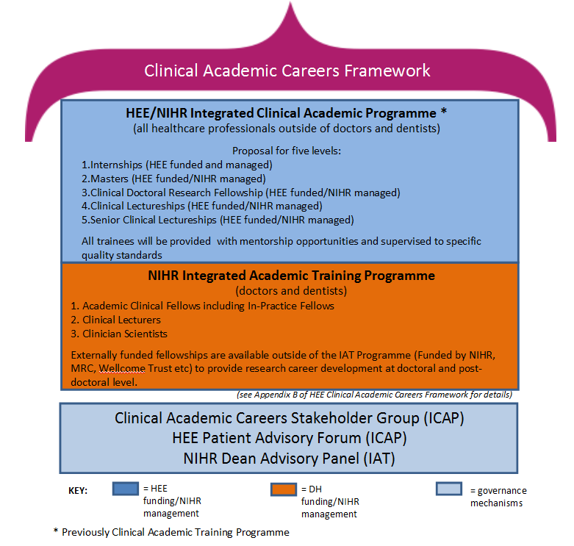

Slide 19
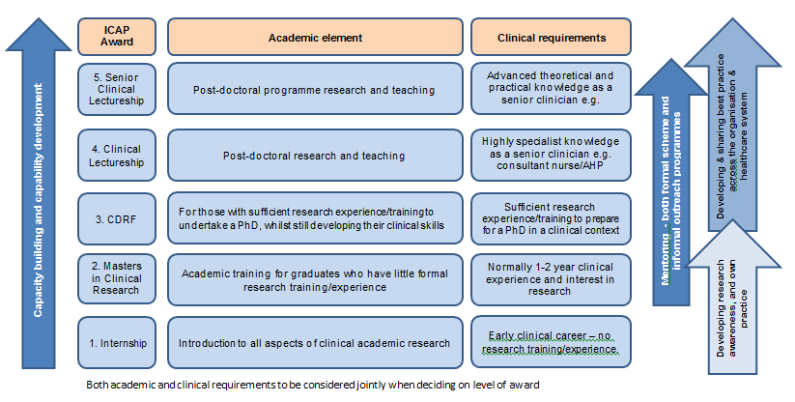

Slide 20
NIHR/HEE/HEEM Research Methods Programme purpose
Attract the most talented individuals to the NIHR/HEE ICA pathway;
Provide training and support for individuals to become clinical academics: careers that combine clinical research and research leadership with continued clinical practice and clinical development
Expand research interests into areas relevant to the NIHR and HEE: conducting research that will result in patient benefit in 3-5 years

Slide 21
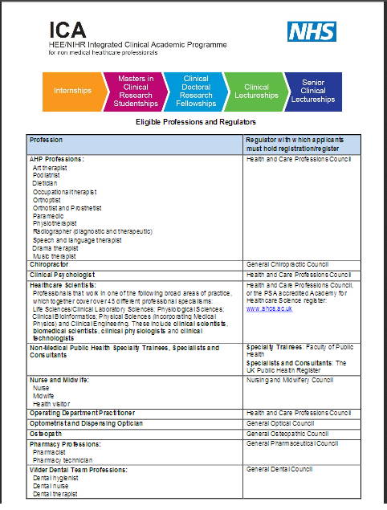
Who can apply?
AHP Professions
Art therapist , Podiatrist , Dietician , Occupational therapist , Orthoptist, Orthotist and Prosthetist , Paramedic , Physiotherapist, Radiographer (diagnostic and therapeutic), Speech and language therapist , Drama therapist, Music therapist
Chiropractors
Clinical Psychologists
Healthcare Scientists
Non-Medical Public Health Specialty Trainees, Specialists and Consultants
Nurses, Midwives and Health Visitors
Operating Department Practitioner
Optometrist and Dispensing Optician
Osteopath
Pharmacists and Pharmacy technician
Wider Dental Team Professions (Dental hygienist , Dental nurse, Dental therapist
http://www.nihr.ac.uk/documents/funding/Training-Programmes/TCC-ICA-Eligible-Professions-and-Registration-Bodies.pdf
Notes:
Applications are invited from clinicians in the East Midlands area (Lincoln, Leicester, Northampton, Derby and Nottingham) who have completed a master degree or equivalent postgraduate qualification and are looking to further develop their clinical academic.

Slide 22
Who can apply?
Applicants must be employed by a provider of health and/or care services that PROVIDES CARE THAT IS FREE FOR AT LEAST 50% OF PATIENTS.
The applicant must also be spending at least 50% of their current role delivering health and/or care serviceS THAT ARE FREE AT THE POINT OF NEED
Meet academic entry requirements of individual programmes of study
http://www.nihr.ac.uk/documents/funding/Training-Programmes/TCC-ICA-Eligible-Professions-and-Registration-Bodies.pdf
Notes:
Applications are invited from clinicians in the East Midlands area (Lincoln, Leicester, Northampton, Derby and Nottingham) who have completed a master degree or equivalent postgraduate qualification and are looking to further develop their clinical academic.

Slide 23
HEEM
WHERE WE ARE NOW
HEE-EM Clinical Scholar Awards are the East Midlands response to the Government’s strategy
Bronze- Pre Mres
Silver – Pre PhD
(Gold – Post doctoral)
Scheme is in its 6th year to date. So far over 90 students have have been through the programme as a whole
48 day FUNDED opportunities (over 6/9 months) for Nurses, Midwives, Allied Health Professionals, Health Visitors, Pharmacists and now Scientists
East Midlands Region beacon of good practice for CAC’s with support from and HEEM
@NHS_HealthEdEng

Slide 24
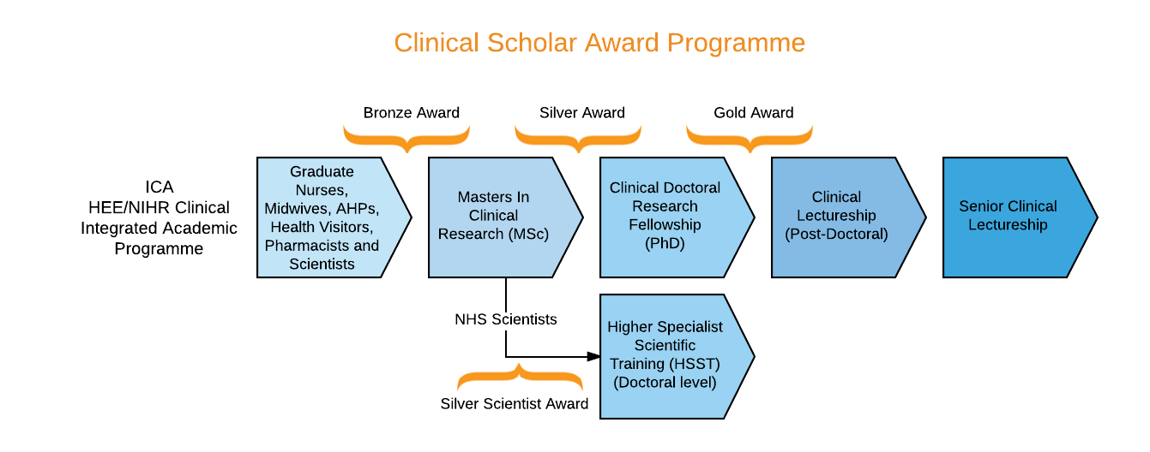
The Clinical Scholar Awards Pathway (HEEM): this is changing from 2018/19
@NHS_HealthEdEng

Slide 25
What do the bronze and silver schemes provide?
Funding to release staff from clinical practice
48 days release from clinical practice for:
mandatory and optional training days
Dedicated time to complete learning outputs
Action learning sets
A clinical and academic mentor
Enhanced ability to compete for the next stage in the awards pathway e.g. Mres/Marm; PhD

Slide 26
what does the maRM provide?
MA Research Methods
Health Pathway
Available as self funded
Available FT or up to 4 years PT self funding
NIHR/HEE funding pathway discontinued ON AN INSTITUTIONAL BASIS from 2018
Notes:
Highlight only available on funded route after been in practice a minimum of 1 year.

Slide 27
HEE/NIHR Pre-doctoral Clinical Academic Fellowships (PCAF) NEW
Awarded to an individual but hosted by an employing organisation, HEI or NHS BODY
AWARD provides:
Up to 50% salary; to cover academic component: either 100% 2 years; 80% 30/12; 60% 40/12
Training an development programme
5K towards masters level training Or can provide full funding for a masters programme of study
1K bursary for conferences,/meetings incl: travel, subsistence and fees
1K towards cost of supervision/mentoring

Slide 28
HEE/NIHR Pre-doctoral Clinical Academic Fellowships (PCAF) new
Graduate from one of the eligible professions
AT least one years post-graduate clinical professional practice
Employed by health or care service provider that is at least 50% publically funded
Applicant must spend at least 50% of their time providing health or care in publically funded services
MUST NOT have registered or completed a PHD

Slide 29
PCAF
CRITERIA
QUALITY OF TRAINING
STRONG ACADEMIC ENVIRONMENT
ACADEMIC SUPERVISION
CAC MENTORSHIP
PROTECTED TIME
Reputation of HEI
Applicant clinical 50% of time

Slide 30
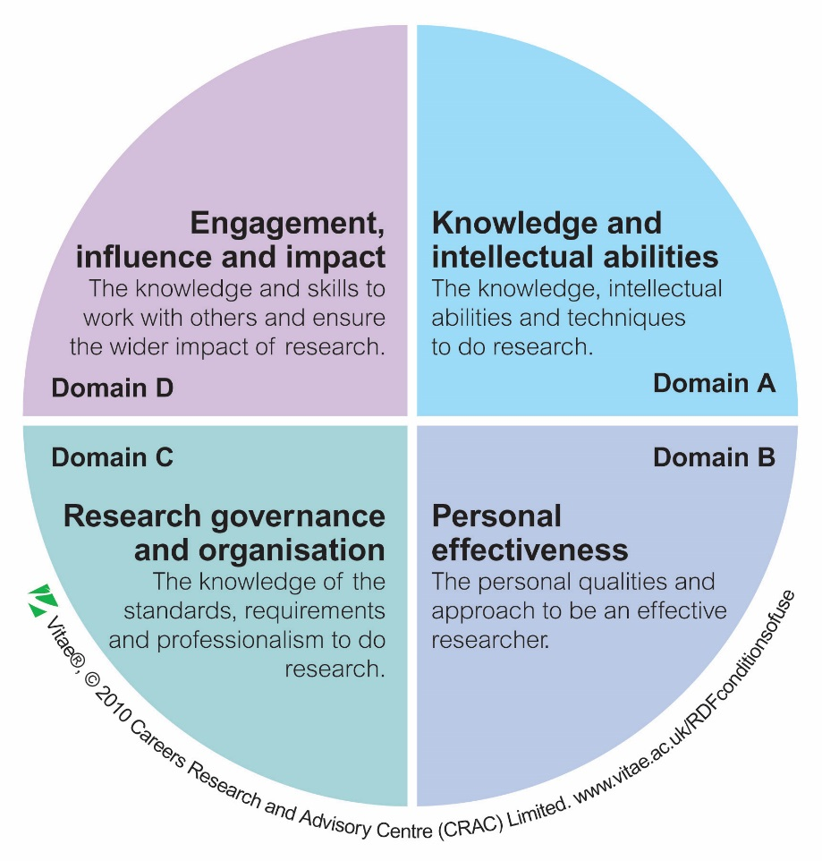
Introducing the Researcher Development Framework (RDF)
The professional development framework to realise the potential of researchers

Slide 31
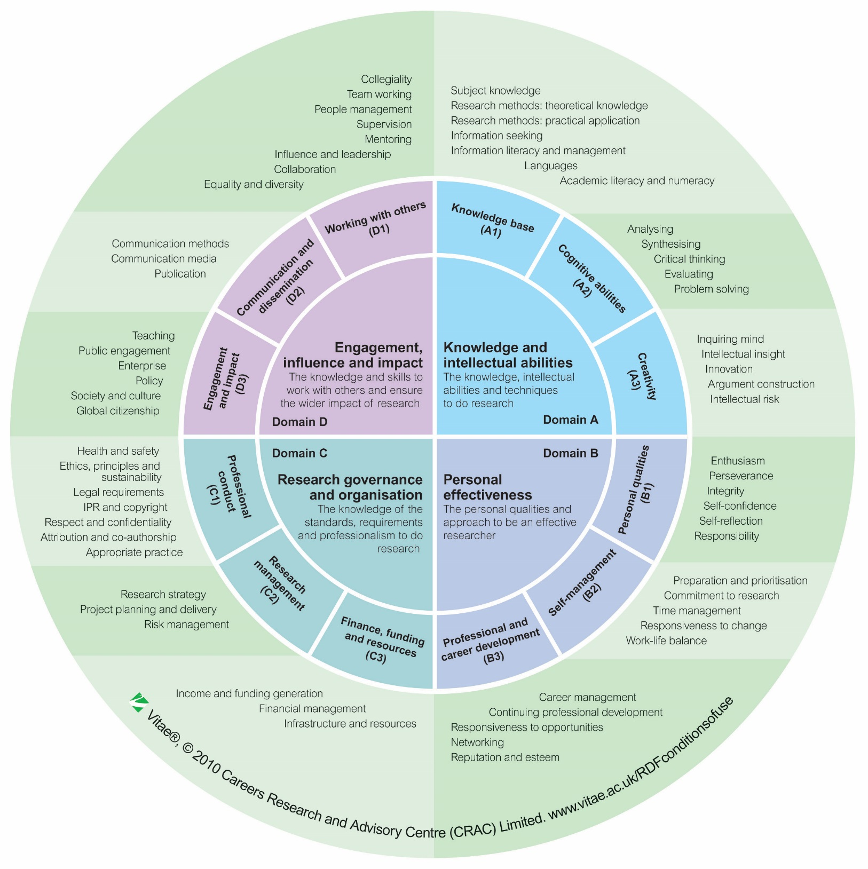

4 domains
12 sub-domains
63 descriptors
Notes:
31
31

Slide 32

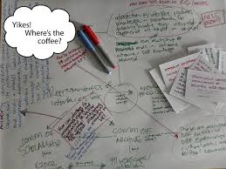

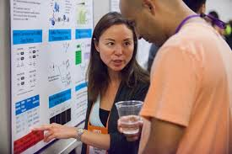
What they all offer
Formal study
Hands on Experience
Bespoke Training
Practical Experience
Exposure to experts
Mentoring
Exposure to researchers, clinicians and networks
Notes:
Silver Scholars will be integrated into the new Faculty of Health Sciences Centre for Doctoral Training in Rehabilitation and Healthcare Research (CDT RHR) [http://www.nottingham.ac.uk/medicine/study/cdt-rhr/index.aspx], directed by Professor Logan. The CDTRHR is physically based within the Division of Rehabilitation and Ageing within a large teaching hospital.

Slide 33
Who should apply?
Research champions
Opinion leaders
Boundary pushers
People seriously considering a future clinical academic career
within HEE/NIHR ICA Programme or another route
Confident Courageous
Determined
Big thinkers
Innovators
People wanting to prepare for PhD funding
Future
clinical
Research Leaders
People with evidence of dissemination

Slide 34
Applications 2018/19
MARM: self funded: through year
Bronze and Silver Scholar Awards Now closed SEE website for further details next year!
http://www.nottingham.ac.uk/clinicalscholar/index.aspx
Guidance notes;
Application forms – Scholars and Mentors
Frequently Asked Questions;
https://www.nottingham.ac.uk/clinicalscholar/faqs.aspx
PCAF
Opens Feb 2018 and closes April 2018

Slide 35

Thinking of applying?
More about the ICA HEE/NIHR Clinical Academic Programme http://www.nihr.ac.uk/funding/nihr-hee-ica-programme.htm
NIHR Guide to developing clinical academic careers
https://www.nihr.ac.uk/news/new-guides-on-clinical-academic-careers-launched/6881
Building a research career: a guide for aspiring clinicians and their managers
www.nihr.ac.uk/documents/faculty/Building-a-research-career-handbook.pdf
Animation: Developing a Clinical Academic Career https://www.youtube.com/watch?v=4KevHrdxQ1M&feature=youtube

Slide 36

HEE/NIHR Pre-doctoral Clinical Academic Fellowships
https://www.nihr.ac.uk/funding-and-support/funding-for-training-and-career-development/training-programmes/nihr-hee-ica-programme/nihr-hee-ica-programme-pcaf.htm
https://www.nihr.ac.uk/funding-and-support/documents/ICA/TCC-ICA-PCAF-Information-for-Prospective-Applicants.pdf
https://www.nihr.ac.uk/funding-and-support/documents/ICA/TCC-ICA-GUIDE.pdf

Slide 37
Useful contacts
Bronze award:
Dr Ros Kane rkane@Lincoln.ac.uk
Dr Ian Mcconagle IMcConagle@Lincoln.ac.uk
MARM:
Dr Alison Edgley alison.Edgley@nottingham.ac.uk
Dr Claire Diver claire.diver@nottingham.ac.uk
Silver award/PCAF:
Dr Kate Radford kate.Radford@nottingham.ac.uk
Dr Claire Diver claire.diver@nottingham.ac.uk

Slide 38
You are PIONEERS
CURRENTLY there are no job descriptions for clinical academics
BUT THERE is a pathway AND
THERE IS a will
BUT you will have to pave the way: be innovative; be persistent; demonstrate the need for CAC’s in your organisation/profession/speciality area

Slide 39

The destination may be unclear when you set off

Slide 40

It might be hard going and enjoyable along the way

Slide 41

BUT with vision and determination you might create your ‘pot of gold’

Slide 42

Questions?

